Slide 1
Instructional Practice Toolkit –
ELA/Literacy

Slide 2
Essential Question
What do the standards and Shifts look like in the classroom?
Notes:
Big Idea: Begin to answer the question: What do the standards and Shifts look like in the classroom?
Details:
Participants can take a few minutes to discuss with colleagues. This can serve as a good icebreaker for the room and an opportunity for the facilitator to understand more about the participants’ perspective about the standards and Shifts.
The conditions necessary for aligned classroom instruction are multiple and interconnected.
There is not just one answer to what aligned instruction looks like, nor is there one answer to what it doesn’t look like.
The best approach we can take as a learning community is to become good at naming what is and what isn’t aligned practice, by collecting and discussing enough examples and non-examples with common tools to be able to confidently identify the conditions necessary for aligned classroom instruction.
This practice will help our learning community reflect on our own systems and practice and decide which efforts are effective and where more resources are necessary to support standards-aligned instruction.

Slide 3
Learning Goals
Examine and discuss evidence of standards-aligned practice using content-specific tools and resources including Instructional Practice Guide (IPG) and Beyond the Lesson Discussion Guide.
Engage with authentic lesson content and discuss the related Shifts and specific standards required (e.g., read the text).
Observe lesson video and gather evidence of teacher and student actions that exemplify standards-aligned instruction.
Analyze and interpret lesson plans and student work to collect and discuss evidence of standards-aligned practice.
Summarize overall trends of standards-aligned practice and discuss implications and next steps based on a variety of specific roles and contexts.
Notes:
Big Idea: The purpose of the slide is to share the goals for the day.
Facilitators may want to adjust the goals, based on the format and audience.
Details:
Effective teaching and learning aligned with CCR standards occur when there is a direct relationship among instructional goals, instructional resources, classroom activities, and the standards.

Slide 4

The Teaching and Learning Cycle
Source: Cherry Creek School District, Colorado
Notes:
Big Idea: Contextualize the components of the Toolkit with the Teaching and Learning Cycle
Details:
The Toolkit brings together tools to analyze lessons from various perspectives to clear picture of what Shifts look like in practice. This Toolkit is designed to highlight the throughline from designing and planning a lesson, to implementing in the classroom, to analyzing student work to see if the intended outcomes were achieved for students. By helping teachers reflect on the entire teaching and learning process, the Toolkit also provides an opportunity to summarize the lesson and identify which aspects of instruction can be adjusted to further align to the standards and Shifts.

Slide 5
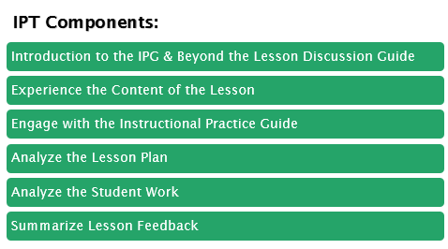
The Instructional Practice Toolkit (IPT) Components
Notes:
Big Idea: This module includes the listed components.
Details:
Through lesson observation and lesson plan and student work analysis, participants will reflect on the Core Actions (and indicators) and how they appear in planning, practice, and student work of lessons that meets the expectations set by CCR standards.
This Toolkit is designed to be flexible. See the Facilitator’s Guide for ideas for scheduling and chunking the activities to best meet your needs. This provides an overall view of the learning, but let your participants know what components they will be working on today vs. future dates.
As best as possible, have participants reflect on each of these three components (observed lesson, lesson plan, and student work) separately and then use the Lesson Feedback Summary document to synthesize what was analyzed and to think about next steps and what can be learned from this experience.

Slide 6
Norms
Be brave! We’re all learning.
Frame all observations using the language of the tools and the standards.
Support every idea with evidence.
Notes:
Big Idea: Set learning expectations with participants. If necessary, add additional norms based on specific audience and purpose.
Details:
In order to norm the way we look at instruction, collectively, we want to root all of our comments in the evidence of the observation, rather than our interpretation of what we see.
We will practice taking low-inference notes throughout the work, and ultimately summarize and interpret the lesson through the lens of the standards and Shifts.

Slide 7
Module Overview
Notes:
Big Idea: Transition participants to the next component of the Toolkit. Participants will now engage in working with the structure of the IPG.

Slide 8
Goals and Activities in this Component
Examine and discuss standards-aligned practice using the Instructional Practice Guide and Beyond the Lesson Discussion Guide.
Notes:
Big Idea: Preview activities within this section.

Slide 9



Key Shifts in ELA/Literacy
Complexity: Practice regularly with complex text and its academic language.
Evidence: Ground reading, writing, and speaking in evidence from text, both literary and informational.
Knowledge: Build knowledge through content-rich nonfiction.
Notes:
Big Idea: The most important instructional Shifts demanded by the CCR standards for ELA/Literacy are: text complexity, evidence, and building knowledge. These Shifts are supported by the college and career readiness research. Refer to the Common Core Shifts for ELA/Literacy (http://achievethecore.org/content/upload/122113_Shifts_ELA.LIT.pdf) handout in your packet.
Details:
Complexity: Regular practice with complex text and its academic language
Evidence: Reading, writing, and speaking grounded in evidence from text
Knowledge: Building knowledge through content-rich nonfiction and informational texts
Depending on the group’s familiarity with the Shifts and time available, participants may be directed to read, underline, and discuss the important concepts in each Shift description from the Common Core Shifts for ELA/Literacy handout.
Background Knowledge:
There is a 1-2 hour introductory module available at www.achievethecore.org, Professional Development: Introduction to the ELA/Literacy Shifts (http://achievethecore.org/page/394/introduction-to-the-ela-literacy-shifts), if you would like more detailed information and training materials about each Shift and the research behind them.
For more information about the research and evidence base for the Standards and Shifts, refer to the Research Supporting the Common Core ELA/Literacy Shifts and Standards (http://achievethecore.org/content/upload/Research%20Supporting%20the%20ELA%20Standards%20and%20Shifts%20Final.pdf).

Slide 10
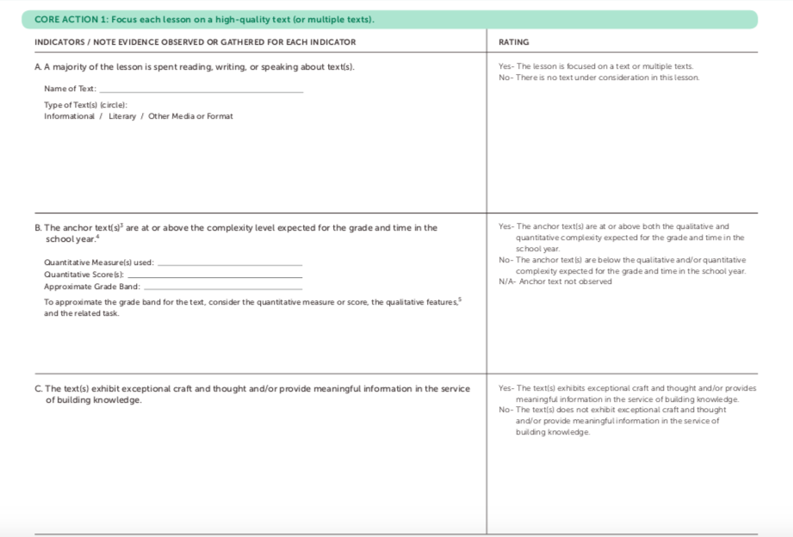
Instructional Practice Guide - Design
Core Actions
  Key Practices
  (numbered sections)
Indicators
  Observable
  (lettered details under each Core Action)
Space for evidence
Notes:
Big Idea: The Instructional Practice Guides (http://achievethecore.org/category/1195/ela-literacy-instructional-practice-toolkit) are available either digitally or in print version. They are designed to be used to observe a single lesson. The tools are designed for use in coaching and collaborating around ELA/Literacy lessons in most education settings and are non-evaluative observation tools. The IPG purposefully focuses on the content of the lesson. Because content expectations vary depending on grade and subject, there are different versions of the IPG. (K-8 and HS for Math and K-2 and 3-12 for ELA/Literacy.)
Details:
Each guide is specific to either K-2, where reading comprehension lessons are based primarily in read aloud and listening, or 3-12 where students are reading the texts themselves.
Each guide has three Core Actions, or key practices, with the observable indicators lettered under each. There is also room for recording notes and evidence for each indicator.
The right side of the table includes a “Ratings” column. Ratings are considered optional and have been designed to offer some guiding language for discussion and calibration.
Not every indicator will be observable in every lesson. Similarly, it is possible that ratings are observed as “No” in Core Action 1 with purposeful evidence.
Background Knowledge:
If participants are new to the IPG, faYcilitators may want to provide an opportunity for participants to highlight key words within each indicator (both from the indicator and rating language.) One way to do this is to have participants highlight the key words throughout the IPG and discuss as a full group. Then have smaller groups do something similar with 1-2 indicators (highlight key words as well as think of examples and non-examples of this indicator). These could be shared on posters and discussed with the full group.
If participants have little experience with the Instructional Practice Guide for ELA/Literacy, consider providing additional training and support using the Introduction to the Instructional Practice Guide for ELA / Literacy Module (http://achievethecore.org/page/1082/ela-literacy-instructional-practice-guide-coaching-tool). The module includes a review of the three instructional Shifts in ELA/Literacy. Within the module, there are activities and discussions based on the Core Actions that will further prepare participants to use the Instructional Practice Guide.

Slide 11

Beyond the Lesson: Discussion Guide
Notes:
Big Idea: The Beyond the Lesson Discussion Guide (http://achievethecore.org/content/upload/Beyond%20the%20Lesson%20Discussion%20Guide_ELA%20Literacy.pdf) provides more opportunity to consider the evidence of the Shifts beyond the scope of a single lesson.
Details:
Have participants get out their copies of the IPG so they can see the Beyond the Lesson Guide and how integral it is to the IPG. It is always the final page of all of the IPGs.
The Beyond the Lesson Discussion Guide is designed for the post-observation conversation using the Instructional Practice Guide Coaching Tool (achievethecore.org/coaching-tool) or any other observation rubric.
The questions put the content of the lesson in the context of the broader instructional plan for the unit or year.
After discussing the observed lesson, select several appropriate “Beyond the Lesson” (BTL) questions to help clearly delineate what practices are in place, what has already occurred, and what opportunities might exist in another lesson, further in the unit, or over the course of the year to incorporate the Shifts into the classroom.
The IPG Coaching Tool only captures one lesson or one day's work but, without addressing what is done before and after and how this lesson fits into the work of a unit or larger time frame it is impossible to gain a valid sense of how instruction is or is not preparing students for college and career over time. The BTL discussion guide questions are designed to address the broader instructional context.
Not all questions need to be raised at once, but all of the questions are of equal importance.
Point out the fact that some of the most crucial CCR standards cannot really be seen in a given lesson. Reading a “range and volume of texts” for example, can only happen over time.
The critical Shift of Building Knowledge, in particular, only happens over months and months of time. Yet it is essential to student success that they be building knowledge systematically over that time.

Slide 12
The Shifts, Core Actions, and Beyond the Lesson
Read/scan the IPG and Beyond the Lesson Discussion Guide
What is the purpose of the Instructional Practice Guide and Beyond the Lesson Discussion Guide?
Consider the Shifts throughout both documents. Which Shift does each Core Action, indicator, or question reflect? Highlight or underline where you see evidence of the Shifts throughout the tools.
Notes:
Big Idea: Connect the ideas behind the Shifts with the IPG and BTL Discussion Guide
Details:
Provide participants with copies of the IPG & BTL Discussion Guide (last page of the IPG)
Allow time for participants to complete the suggested activities on the slide at their tables. They should be able to identify all three Shifts within the IPG and the Beyond the Lesson Discussion Guide. If you have ample time, provide three different-colored highlighters to the participants so they can color code the document by Shifts.

Slide 13
Reflection
Based on your role in the learning community, how do content-specific tools support your work?
Based on your role in the learning community, what resources and strategies could be used to incorporate content-specific tools in your work?
Notes:
Big Idea: Consider the implications of qualitative analysis on the lesson planning and observation/coaching process.
Details:
The questions provided on the slide are general reflection questions; however, the reflection questions should be adjusted by the facilitator to best meet the specific learning needs of the audience.
Based on your role in the learning community, how do content-specific tools support your work?
Superintendent/District Leader
School Leader
Coach
Teacher
Parent
Partner organization

Slide 14
Module Overview
Notes:
Big Idea: Transition participants to the next component of the Toolkit. Participants will now engage in working with the IPG, Core Actions, and indicators
Details:
Let’s begin thinking about Core Action 1 by reading the text featured in today’s lesson, analyzing the qualitative features of the text, and considering the text as it relates to Core Action 1.
Background Knowledge:
If participants have little experience with analyzing text complexity, refer to the following activity: Core Action 1 Reading/Listening (http://achievethecore.org/page/1082/ela-literacy-instructional-practice-guide-coaching-tool - found as an option on the right side of the page). This activity involves participants in practicing evaluating the complexity and quality of a sample text. Quantitative, qualitative, and reader and task considerations, introduced in the presentation, are practiced and followed with a model response.

Slide 15
Goals and Activities in this Component
Engage with authentic lesson content and discuss the related Shifts and specific standards required (e.g., read the text).
Zoom into IPG: Core Action 1
Analyze Text Complexity
Familiarize yourself with the text and conducting qualitative analysis.
Notes:
Big Idea: Preview activities within this section.

Slide 16
Core Action 1 - Reading/Listening Comprehension
Focus each lesson on a high-quality text
(or multiple texts).
Indicators:
A majority of the lesson is spent reading, writing, or speaking about text(s).
The anchor text(s) are at or above the complexity level expected for the grade and time in the school year.
The text(s) exhibit exceptional craft and thought and/or provide meaningful information in the service of building knowledge.
Notes:
Big Idea: Core Action 1--Focus each lesson on a high quality text (or multiple texts)--reflects the priorities of the CCR standards.
Details:
If students are going to be successful in meeting Reading Standard 10--By the end of the grade band, read and comprehend texts at the high end of the text complexity band independently and proficiently--instruction and practice must be provided. This does not mean that all instruction must focus around complex text; a wide volume of reading must also be included in CCR-aligned instruction, but a focus on high-quality text must be evident in classroom practice.
Evidence for indicator 1A is only observable during the lesson.
Evidence for indicator 1B and 1C may be provided in the lesson plan, by asking the teacher, or by reading and analyzing the text for complexity and quality.
For 1B - Refer to achievethecore.org/ela-literacy-common-core/text-complexity/ for text complexity resources.
If complexity information in not available or evident, some due diligence may be required to determine the information. Asking the teacher is a first step, or follow the guidance of the following slides to determine.

Slide 17
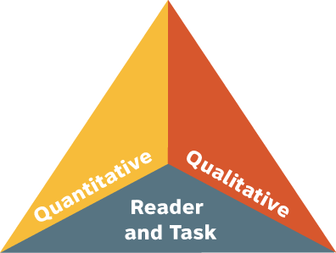
Three Factors of Text Complexity
Quantitative Scale: What a computer can “see” and measure
Qualitative Measures: Text features best judged by human evaluation (structure, language and knowledge demands, and purpose)
Professional Judgment: Consider the appropriateness of the text for student and task.
Notes:
Big Idea:
Three factors determine the complexity of a text – quantitative, qualitative measures and reader and task (professional judgment) considerations.
Details:
Text complexity is the focus on indicator 1B from the IPG.
Use quantitative tools to identify the grade band of a particular text. After identifying the grade band for a text, use qualitative tools to determine its specific grade level and what features will make it challenging for students.
Background Knowledge:
More information on text complexity can be found here: http://achievethecore.org/page/2725/text-complexity
NOTE: More detail is coming on the next slides.

Slide 18
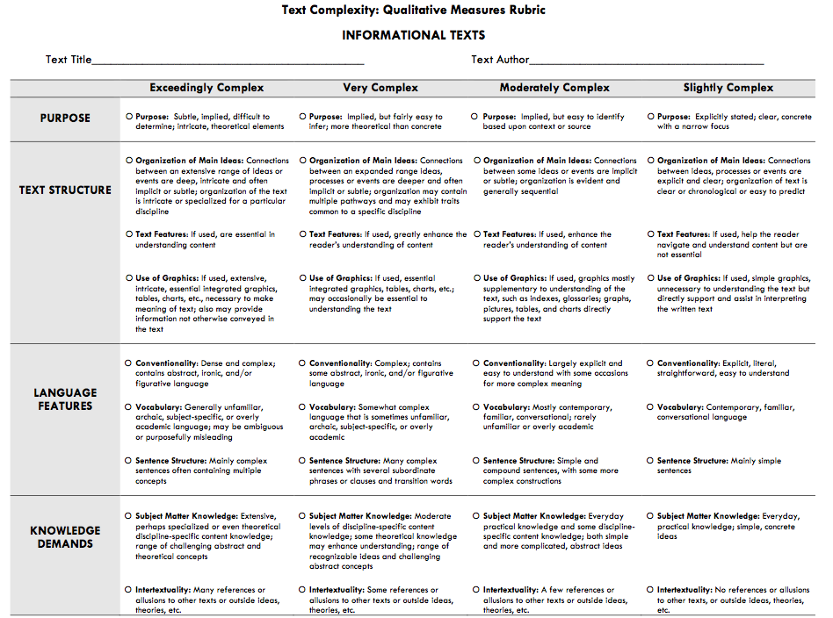
Qualitative Measures
Notes:
Big Idea:
The qualitative features of the text at the center of the lesson are critical content considerations for standards-based instruction.
Details:
Determining the instructional moves and implications required by this Shift is the emphasis of Core Action 1.
Beyond determining the complexity of the text, conducting a qualitative analysis helps teachers know what to emphasize in their teaching complex texts (as demanded by Core Action 2, Indicator A which we will explore further in a moment). For example, is the structure of the text particularly difficult and requires explicit instruction in order for students to understand the meaning of the text?

Slide 19
Qualitative Analysis
Read the text featured in the lesson.
Complete the “What Makes This Text Complex?” sheet.
Use the information gathered about the text to provide evidence for indicators 1B and 1C from the IPG.
Notes:
Big Idea:
A college- and career-aligned lesson will depend upon how the qualities of the text impact lesson design. It is helpful for the observer to gain a rudimentary understanding and for the teacher to have a deep understanding of the text and its qualities when considering the lesson.
Details:
Provide participants with a copy of the text and the handout “What Makes this Text Complex?” Provide the following directions:
Look at the quantitative measures listed at the top of the “What Makes this Text Complex?” handout. Determine in what grade band the text belongs. If necessary, the facilitator could provide the participants with the quantitative measure using the information on model response.
Review the Qualitative Analysis Rubric for Literary or Informational Texts (based on the genre of the text featured in the lesson).
Using the “What Makes this Text Complex?” worksheet, for each category or text feature (structure, language clarity and conventions, knowledge demands, and purpose), provide evidence in the blank space for why you think the text is or is not especially challenging in that category.
Have participants share insights and discuss any points of agreement or disagreement. Rather than discussing the rating itself, focus on the evidence from the text that supports your rating on the qualitative rubric.
Refer to the completed “What Makes this Text Complex? – Model Response.” Compare participants’ responses with the sample model response. Participants may also be provided with the sample model response analysis after the activity has been completed and discussed.

Slide 20
Reflection
Based on your role in the learning community, how does analyzing the text at the center of the lesson help you to think about students engaging with this text?
Based on your role in the learning community, what resources and strategies could be used to provide students with access to a range of complex texts?
Notes:
Big Idea: Consider the implications of qualitative analysis on the lesson planning and observation/coaching process.
Details:
The questions provided on the slide are general reflection questions; however, the reflection questions should be adjusted by the facilitator to best meet the specific learning needs of the audience.
Based on your role in the learning community, how does analyzing the text at the center of the lesson help you to think about students engaging with this text:
Superintendent/District Leader – How are resources directed to provide classrooms with a range of complex texts?
School Leader – What building conditions must exist to provide classrooms with a range of complex texts?
Coach - How can content-based feedback help prioritize professional learning and coaching activities to support teachers’ implementation of complex texts?
Teacher – Which aspects of your instructional practice provides all students with access to grade-level complex texts? Which aspects do not?
Parent – Where do you see evidence of your child’s success and challenges with complex texts?
Partner organization – How does our organization’s theory of action and activities with districts partners support students’ access to complex texts?
How often do participants analyze texts featured in lessons?
Is this part of the culture of professional learning in your setting?
Based on your role in the learning community, what resources and strategies could be used to provide students with access to a range of complex texts?
Note: this type of activity is not something that has to be done with every text every time; the learnings from this should be translated through practice in a reasonable way
Background Knowledge:
For additional resources and practice with text complexity refer to the Text Complexity resources (http://achievethecore.org/page/2725/text-complexity) on achievethecore.org.

Slide 21
Module Overview
Notes:
Big Idea: Transition participants to the next component of the Toolkit. Participants will now learn about the indicators for Core Actions 2 and 3 and observe the lesson using the IPG.

Slide 22
Goals and Activities in this Component
Observe lesson video and gather evidence of teacher and student actions that exemplify standards- aligned instruction.
Dive into IPG: Core Actions 2 & 3
Watch the lesson video.
Complete the IPG Coaching Tool.
Notes:
Big Idea: Preview activities within this section.

Slide 23
Core Action 2
Employ questions and tasks, both oral and written, that are text-specific and accurately address the analytical thinking required by the grade-level standards.
Indicators:
Questions and tasks address the text by attending to its particular qualitative features: its meaning/purpose and/or language, structure(s), or knowledge demands.
Questions and tasks require students to use evidence from the text to demonstrate understanding and to support their ideas about the text. These ideas are expressed through written and/or oral responses.
Questions and tasks attend to the words (academic vocabulary), phrases, and sentences within the text.
Questions are sequenced to build knowledge by guiding students to delve deeper into text and graphics.
Notes:
Big Idea: Core Action 2 focuses on the use of quality questions and tasks being integrated with the high quality text of Core Action 1. This is the second component of core-aligned classroom practice: “employ questions and tasks, both oral and written, that are text-specific and accurately address the analytical thinking required by the grade-level standards.
Details:
If participants do not have experience using the IPG, it will be helpful to have the group dive into the individual indicators.
Either individually or in pairs, assign each of the indicators to one person/pair.
Ask participants to underline 4-6 key words in the indicator and the rating.
Ask participants to generate an example of what this might look like in a classroom.
Have participants share out on each indicator.}
Indicator A: When thinking about collecting evidence for this action, it is important to refer to qualitative complexity features identified in Core Action 1, Indicator B; questions and tasks observed should attend to the qualitative features previously identified from an analysis of text complexity. It is also important to consider the Standards. Questions might be text-dependent or text-specific but not reach the level the Standards expect. (For example, “What is the author’s purpose?” versus “What words in the text evidence the author’s purpose for the text?”)
Indicator B for 3-12 reads, “ Questions and tasks require students to use evidence from the text to demonstrate understanding and to support their ideas about the text. These ideas are expressed through both written and oral responses.” Note the difference in indicator B of the k -2 document which states that drawing and dramatic play is also appropriate for K - 2 students.
Indicator C captures the focus on vocabulary and syntax (consider how difficult this is to do if the text is not of sufficient complexity)
Indicator D reinforces the idea that reading is done to gain meaning. A series of right there text-dependent questions might let a teacher know if a student can decode and understand a section, but a series of well-crafted questions will support student understanding and knowledge building.
Background Knowledge:
CA 2 activities (http://achievethecore.org/page/1082/ela-literacy-instructional-practice-guide-coaching-tool)
and Text-Dependent Questions resources
(http://achievethecore.org/category/1158/ela-literacy-text-dependent-questions)

Slide 24
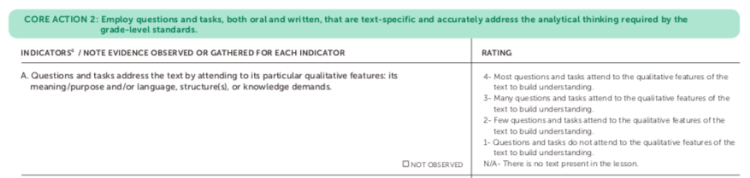
Core Action 2
Rating scale
Notes:
Big Idea: This slide illustrates the rating categories for Core Action 2
Details:
Here, each of the indicators includes scale ranking that allows an observer (or the teacher him/herself) to consider to what degree the indicator is observed during the lesson.
The scale is designed to allow for a progression, so a teacher can consider ways to improve.
Note that, in using a scale, it is our nature to want to be at the highest rank. Because this is designed as a coaching tool and not an evaluation tool, the scale rankings should be focus for conversation, rather than a “good” or “bad” indicator.
As shown in a footnote in the IPG, not every indicator will be evident in all lessons that are taught and observed. However, some or most of the indicators should be observable. In the case where an indicator is not observed in a lesson, it should be left blank.

Slide 25
Core Action 3
Provide all students with opportunities to engage in the work of the lesson.
Indicators:
The teacher poses questions and tasks for students to do the majority of the work: speaking/ listening, reading, and/or writing. Students do the majority of the work of the lesson.
The teacher cultivates reasoning and meaning making by allowing students to productively struggle. Students persevere through difficulty.
(continued on next slide)
Notes:
Big Idea: Core Action 3 - Provide all students with opportunities to engage in the work of the lesson - is focused on productive engagement. Notice that these indicators include teacher action matched with student behavior.
Details (for this slide):
If participants do not have experience using the IPG, it will be helpful to have the group dive into the individual indicators.
Either individually or in pairs, assign each of the indicators to one person/pair.
Ask participants to underline 4-6 key words in the indicator and the rating.
Ask participants to generate an example of what this might look like in a classroom.
Have participants share out on each indicator.
Provide a few moments for participant to discuss what they see as the difference between A and C. (Tasks may be challenging as A indicates, but C also speaks to the quality of tasks. Work worth doing.)
Details for Core Action 3 slides: (the indicators C-F continue on the next slide; the bullets below are the same notes for both slides)
Let’s consider what evidence for these indicators might look like.
Are the students doing the majority of the work of reading, writing, speaking or listening?
How does the teacher provide opportunities for students to persist through challenges?
Were students able to successfully respond to the text-dependent questions and tasks with precision?
What strategies did the teacher utilize to encourage discourse between students? To what extent are students talking to one another about each other’s thinking?
How does the teacher evaluate student understanding and adjust the lesson accordingly?

Slide 26
Core Action 3
Provide all students with opportunities to engage in the work of the lesson.
Indicators (continued):
The teacher expects evidence and precision from students and probes students’ answers accordingly. Students provide text evidence to support their ideas and display precision in their oral and/or written responses.
The teacher creates the conditions for student conversations where students are encouraged to talk about each other’s thinking. Students talk and ask questions about each other’s thinking, in order to clarify or improve their understanding.
The teacher deliberately checks for understanding throughout the lesson and adapts the lesson according to student understanding. When appropriate, students refine written and/or oral responses.
When appropriate, the teacher explicitly attends to strengthening students’ language and reading foundational skills. Students demonstrate use of language conventions and decoding skills, activating such strategies as needed to read, write, and speak with grade-level fluency and skill.
Notes:
Big Idea: Core Action 3--Provide all students with opportunities to engage in the work of the lesson--is focused on productive engagement. Notice that these indicators include teacher action matched with student behavior.
Details: (for indicator 3C)
Provide a few moments for participant to discuss what they see as the difference between A and C. (Students may be doing the work as stated in indicator A, but indicator C speaks to the quality of student responses and the teacher’s work to support them. Work worth doing.)
Details for Core Action 3 slides: (the indicators C-F continue on the next slide; the bullets below are the same notes for both slides)
Let’s consider what evidence for these indicators might look like.
Are the students doing the majority of the work of reading, writing, speaking or listening?
How does the teacher provide opportunities for students to persist through challenges?
Were students able to successfully respond to the text-dependent questions and tasks with precision?
What strategies did the teacher utilize to encourage discourse between students? To what extent are students talking to one another about each other’s thinking?
How does the teacher evaluate student understanding and adjust the lesson accordingly?

Slide 27
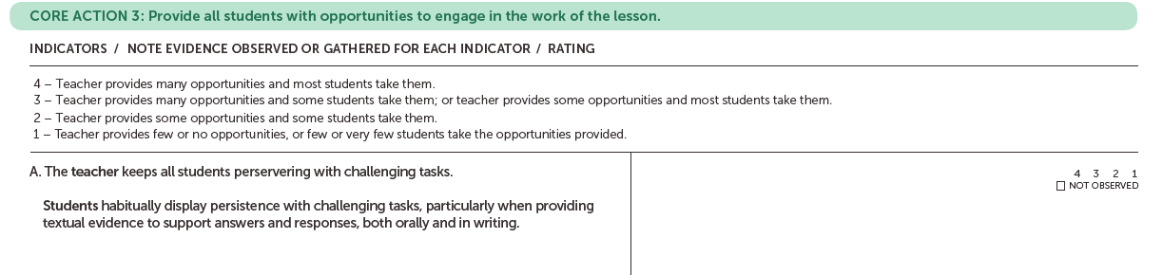
Core Action 3
Rating scale
Teacher behavior
Student behavior
Notes:
Big Idea: Core Action 3--Provide all students with opportunities to engage in the work of the lesson--is focused on productive engagement. Notice that these indicators include teacher action matched with student behavior.
Details:
Here, each of the indicators includes scale ranking that allows an observer (or the teacher him/herself) to consider to what degree the indicator is observed during the lesson.
The scale is designed to allow for a progression, so a teacher can consider ways to improve.
Note that, in using a scale, it is our nature to want to be at the highest rank. Because this is designed as a coaching tool and not an evaluation tool, the scale rankings should be focus for conversation, rather than a “good” or “bad” indicator.
As shown in a footnote in the IPG, not every indicator will be evident in all lessons that are taught and observed. However, some or most of the indicators should be observable. In the case where an indicator is not observed in a lesson, it should be left blank.

Slide 28
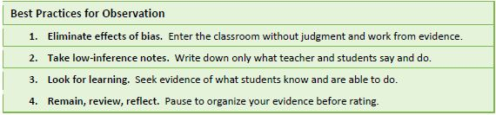
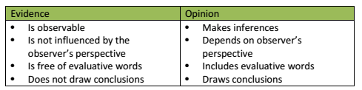
Guidance: Taking Low-Inference Notes
Source: We Teach NYC
Notes:
Big Idea: Best Practices for Low Inference Notes
Details:
Capturing high-quality notes during the observation is the first step in ensuring that ratings are accurate and feedback aligns to areas of improvement. Low-inference note-taking is a skill, not knowledge; it comes with practice. When taking low-inference notes, the observer describes what is taking place without drawing conclusions or making judgments about what he or she observes.
The resource, The Observation and Feedback Cycle: Best Practices for Low Inference Notes (https://www.weteachnyc.org/media2016/filer_public/2a/d3/2ad3839f-eeae-42ba-8249-614b33136717/best_practices_for_low_inference_notes.pdf), is provided to build knowledge and capacity for this important skill.
Low-inference notes will provide an objective evidence base for reviewing and discussing the lesson throughout the Toolkit.
Encourage participants to collect low-inference notes as often as possible. Remind participants to assume the role of researcher rather than evaluator and of coach rather than supervisor. The intent is not to pass judgment, but to highlight effective practices and to create a way to identify improvements needed and share best practices.
If necessary:
Distribute the handout: The Observation and Feedback Cycle: Best Practices for Low Inference Notes
Discuss questions or comments based on the guidance provided.

Slide 29

Watch the Lesson Video
Take low-inference notes. What do you see and hear?
Keep in mind CA 1A, CA 2 and CA 3, but don’t complete the Instructional Practice Guide yet.
Notes:
Big Idea: Now that we’ve worked through all of the Core Actions, we’ll practice putting it all together and using the guide using a tool to focus conversations.
Details:
Watch the lesson video (approximately 30 minutes run time for the edited video); collect and record low-inference notes. Assume positive intentions of the teacher and that he/she does what he/she thinks is in the best interest of his/her students. If you question what they’re doing, think about why someone might be think it’s the right thing to do. Be open and curious about what you see!
Remind participants to pay close attention to teacher-student interactions during the lesson: What does the teacher say and do? How are students engaged in the lesson and how does the teacher encourage that engagement? How are students demonstrating their understanding, their strategies for answering questions or completing tasks? If necessary, suggest that participants use a simple t-chart to track what teacher says/does on one side and what students say/do on the other.
It may be challenging for participants to keep track of everything teachers and students are saying a doing while watching the video. If necessary:
Facilitators may want to have participants watch the video once before the session (as pre-work) without taking notes. Similar to the “first read” of a text, watching the video will simply provide participants with the gist of the lesson before focusing on collecting low-inference notes and/or engaging with the IPG.
Important note: Be sure that participants track every question asked or task explained throughout the lesson. This is will be important evidence to consider for Core Action 2.
Participants should not yet be concerned with putting their notes into the evidence sections in the IPG. They should just capture notes and will have the opportunity to apply notes to the indicators for the IPG immediately after watching the video.
Participant may also note open questions or wonderings they may have as they watch the lesson.
Links:
Grade 5: Text-Based Disagreement During Discussion: link to video (https://vimeo.com/197893087) & link to transcript (https://achievethecore.org/content/upload/Text-Based%20Disagreement%20During%20Discussion%20(Grade%205).pdf)
Grade 7: Using Complex Text to Build Content Knowledge: link to video(https://vimeo.com/227751562) & link to transcript (https://achievethecore.org/content/upload/Using%20Complex%20Text%20to%20Build%20Content%20Knowledge%20-%20Abbreviated%20Video.pdf)

Slide 30
After Watching the Lesson Video – Complete the Instructional Practice Guide
Spend time individually applying the low-inference notes you gathered from the lesson video to the indicators under each of the Core Actions.
Discuss the indicators and share the evidence with colleagues.
Notes:
Big Idea: Complete and discuss evidence for the indicators of the IPG. Create consensus on evidence for each indicator and the strengths and weaknesses of the lesson (Note: the purpose of this activity is not to come to consensus on the rating for each indicator)
Details:
Complete the IPG Coaching Tool by providing observational evidence for the appropriate indicators. It is not recommended that participants give ratings for each indicator so that the discussion can focus on identifying evidence that aligns to each indicator.
Although we are asking for evidence tied to each indicator, participants should note missed opportunities or times when the teacher or student did not engage in the indicator, as well as times when each indicator is being met.
After individually completing the IPG Coaching Tool, discuss first with a partner or in small table groups, then discuss evidence. Share reflections as a whole group.
Some options for sharing: Have participants norm as a small group and then share with the full group (can be done with concretely using poster paper and post-it notes or digitally using a google doc spreadsheet.) It’s is often interesting to discuss indicators where there isn’t consensus.
After discussing, participants may want to note specific strengths and specific areas in need of growth to be used later in the lesson feedback summary. (Don’t use feedback summary form yet.)
Refer to the completed IPG Coaching Tool – Model Response for the model response for the lesson. Compare participants’ responses with the model response.
Important Facilitation Note:
At this time, ratings are not provided in the model response; only video-specific evidence is provided for the appropriate indicator to support clearly identifying evidence of standards-aligned practice and facilitate the group discussion.
If calibration is a key goal of the training, additional time will be required to facilitate the norming process. Discussions about ratings and evidence will support the calibration process.
Optional: If you would like a tool to capture evidence you may use the tool found here (note - you will need to download and prepare this in advance): https://docs.google.com/spreadsheets/d/1QYSjvH7CqEh2UVWzGlMGqhdm1TcY2Hxcli_lsR0Rm6U/edit?usp=sharing

Slide 31
Beyond the Lesson Guide
“After discussing the observed lesson, use the ‘Beyond the Lesson’ questions to help clearly delineate what practices are in place, what already occurred, and what opportunities might exist in another lesson, further in the unit, or over the course of the year to incorporate the Shifts into the classroom.”
Review the questions from the Beyond the Lesson Discussion Guide.
Which questions would you prioritize for this lesson? Why?
Notes:
Big Idea: The Beyond the Lesson Guide is a good resource for questions that may come up in observing a single lesson.
Classroom observations are by definition limited to what you see while you are present in the room.
But learning happens over the course of days, across the weeks and months of the school year. That needs to be accounted for in the coaching conversations with teachers.
Details:
Although we just identified strengths and areas for growth based on the video, we may be left with other questions.
The Beyond the Lesson Guide is a great resource for helping us frame the questions. We are going to take a quick look at it now and then revisit it when we are summarizing all of the things we learned about this lesson.
Have participants briefly discuss at their table which questions would help illuminate the lesson they just observed.

Slide 32
Reflection
Based on your role in the learning community, how did looking at the lesson through the lens of the IPG and Beyond the Lesson Discussion Guide help you to think about standards-aligned instruction in the classroom?
Based on your role in the learning community, what resources and strategies could be used to support standards-aligned practice in classrooms?
Notes:
Big Idea: Consider the implications of observing a lesson with the IPG.
Details:
The questions provided on the slide are general reflection questions; however, the reflection questions should be adjusted by the facilitator to best meet the specific learning needs of the audience.
Based on your role in the learning community, how did looking at the lesson through the lens of the IPG and Beyond the Lesson Discussion Guide help you to think about standards-aligned instruction in the classroom in your work as a:
Superintendent/District Leader – How are resources directed to support standards-aligned practices in classrooms?
School Leader – What building conditions must exist to encourage and support standards-aligned practices in the classroom?
Coach - How can content-based feedback help prioritize professional learning and coaching activities to support standards-aligned practices in the classroom?
Teacher – Which aspects of your instructional practice provides all students with access to grade-level standards-based content and tasks? Which aspects do not?
Parent – Where do you see evidence of your child’s day-to-day experience with standards-aligned grade-level content in school?
Partner organization – How does our organization’s theory of action and activities with districts partners support standards-aligned practice in the classroom?
Based on your role in the learning community, what resources and strategies could be used to support standards-aligned practice in classrooms?

Slide 33
Module Overview
Notes:
Big Idea: To get a full picture of instruction, it is important to consider the other important aspects of the teaching and learning cycle. The lesson plan can provide additional insight into what was planned and the goals for the lesson.
Details:
You are looking at the lesson plan after observing the lesson, not before. This allows observers to come to lessons without the benefit of advance details about what to expect—just as students do daily. For this reason, the Lesson Plan Analysis happens after watching the video. The sole focus is to illuminate what was observed during the lesson.
Let’s take a look at the lesson plan for the video we just watched.

Slide 34
Goals and Activities in this Component
Analyze and interpret the lesson plan to collect and discuss evidence of standards-aligned practice.
Review the guiding questions related to each Core Action in the Lesson Plan Analysis.
Respond to the questions using evidence from the lesson plan provided.
Notes:
Big Idea: Consider the lesson plan and its implications through the lens of the IPG Coaching Tool.
Details:
Provide participants with a copy of the lesson plan and the Lesson Plan Analysis participant handout.
Prompt participants to take the lesson plan at face value. Ask them to limit their observations to what the lesson plan communicates about its purpose; they should not make assumptions or assign purposes to it that are not readily evident. Reinforce low-inference notes.
As much as possible, participants should use the lesson plan only, not what was observed in the video lesson, to complete the Lesson Plan Analysis handout.
It is also important to note that is highly unlikely to see all of these questions answered in a plan for an individual lesson and that this not meant to be a checklist of what has to be included in every lesson plan.
Responses for each Core Action can be a narrative rather than written as individual responses to each question separately.
After individually completing the Lesson Plan Analysis handout, first discuss evidence and responses with a partner or in small table groups, then share reflections as a whole group.
After discussing, participants may want to note specific strengths and specific areas in need of growth to be used later in the lesson feedback summary. (Don’t use lesson feedback summary form yet.)
If appropriate, you may have the group discuss how the lesson plan analysis illuminated aspects of the lesson observation.
Refer to the completed Lesson Plan Analysis – Model Response. Compare participants responses with the model response. Participants may also be provided with the model response after the activity has been completed and discussed. Use completed version to spark conversation about the plan that participants may not have highlighted.

Slide 35
Reflection
Based on your role in the learning community, how did analyzing the lesson plan help you to think about the impact of curriculum resources on instructional practice?
Based on your role in the learning community, what resources and strategies could be used provide all classroom access to standards-aligned curriculum resources?
Notes:
Big Idea: Consider the implications of the Lesson Plan Analysis
Details:
The questions provide on the slide are general reflection questions; however, the reflection questions should be adjusted by the facilitator to best meet the specific learning needs of the audience.
Based on your role in the learning community, how did examining the lesson plan help you think about the impact of impact of curriculum resources on instructional practice in your work as a:
Superintendent/District Leader – How are resources directed to provide standards-aligned curriculum materials in classrooms?
School Leader – What building conditions must exist to provide all classrooms with access to standards-aligned curriculum materials?
Coach - How can content-based feedback help prioritize professional learning and coaching activities to support teachers’ implementation of standards-aligned curriculum resources?
Teacher – Which aspects of your planning process provides all students with access to grade-level standards-based content and tasks? Which aspects do not?
Parent – Where do you see evidence of your child's success and challenges with standards-aligned grade-level content?
Partner organization – How does our organization’s theory of action and activities with districts partners support improved student outcomes with standards-aligned instruction?
Based on your role in the learning community, what resources and strategies could be used provide all classrooms access to standards-aligned curriculum resources?
Background Knowledge:
Refer to the Lesson Planning Tool (http://achievethecore.org/lesson-planning-tool/) on achievethecore.org to practice planning with the CCR standards in mind. The Lesson Planning Tool (digital version only) guides teachers through a series of prompts about the lesson content, structure, and activities to ensure the Shifts required by CCR standards are central to the lesson. References to Core Actions and indicators found in the IPG can be found throughout the Lesson Planning Tool. Teachers using the lesson planning tool with a coach or colleague can use these references to more easily make connections between what CCR-aligned content and practice has been planned and what is to be observed during classroom instruction. These lessons can be easily shared with a coach in advance of a non-evaluative observation focused on CCR-aligned classroom instruction.
Refer to the Instructional Materials Evaluation Tool (IMET) (http://achievethecore.org/page/1946/instructional-materials-evaluation-tool) to evaluate comprehensive textbook or textbook series for alignment to the Shifts and major features of the CCSS. For use with ELA/literacy materials for grades K-2 or 3-12 and for mathematics materials K-8 or high school. The IMET is a tool within the Materials Alignment Toolkit (http://achievethecore.org/page/1097/toolkit-portfolio), developed in partnership with Achieve, the Council of Chief State School Officers (CCSSO) and the Council of Great City Schools (CGCS).
Use this tool to:
Inform decisions about purchasing curriculum materials
Evaluate previously purchased materials to identify neces­sary modifications to align more closely to the standards and Shifts
Build understanding of what aligned materials look like
Instructional Materials Evaluation Tool (http://achievethecore.org/page/1946/instructional-materials-evaluation-tool)
Also included in the Materials Alignment Toolkit are EQuIP (Educators Evaluating the Quality of Instructional Products) rubrics which are designed to help educators evaluate standards alignment of multi-day lessons in ELA/Literacy, Mathematics and Science. The rubrics and training materials are available from Achieve (https://www.achieve.org/).
EdReports.org is an independent nonprofit that publishes free reviews of instructional materials, using an educator-designed tool that measures alignment, usability, and other quality criteria. The reports help districts and educators make informed purchasing and instructional decisions that support improved student outcomes. Refer to EdReports for completed analyses of curriculum materials and lessons for both Mathematics and ELA/Literacy.

Slide 36
Module Overview
Notes:
Big Idea: To get a full picture of instruction, it is critical to examine how effective the lesson was for student mastery of the subject matter (“We think we taught x. What did the students actually learn?”). Student outcomes are another important aspect of the teaching and learning cycle.
Details:
Let’s take a look at student work samples from the video we just watched.
Insights from examining the assignment and student work will further inform related instructional approaches that occurred during the lesson. It will allow observers to help teachers monitor the effectiveness of their lessons and then be ready to make/suggest adjustments that will make instruction and learning stronger.

Slide 37
Goals and Activities in this Component
Analyze and interpret student work to collect and discuss evidence of standards-aligned practice.
Review the guiding questions related to each Core Action in the Student Work Analysis.
Respond to the questions using evidence from the student work samples provided.
Notes:
Big Idea: Consider the student work through the lens of the IPG Coaching Tool.
Note: The Student Work Analysis is based on the EQuIP Student Work Protocol (http://achievethecore.org/content/upload/EQuIP_Student%20Work%20Protocols.pdf). It has been modified for length and adapted to align to the Core Actions of the IPG.
Details:
Provide participants with a copies of the student work samples and the Student Work Analysis participant handout.
Prompt participants to take the assignment at face value. Ask them to limit their observations to what the assignment communicates about its purpose; they should not make assumptions or assign purposes to it that are not readily evident. Reinforce low-inference notes.
The student work has not been edited and therefore doesn’t necessarily represent exemplary materials.
As much as possible, participants should use the student work only, not what was observed in the video lesson or the lesson plan, to complete the Student Work Analysis handout.
After individually completing the Student Work Analysis handout, first discuss evidence and responses with a partner or in small table groups, then share reflections as a whole group.
After discussing, participants may want to note specific strengths and specific areas in need of growth to be used later in the lesson feedback summary. (Don’t use the lesson feedback summary form yet.)
If appropriate, you may have the group discuss how the student work analysis illuminated aspects of the lesson observation.
Refer to the completed Student Work Analysis for the model response of the work samples. Compare participants responses with the model response. Participants may also be provided with the model response after the activity has been completed and discussed.

Slide 38
Reflection
Based on your role in the learning community, how did analyzing the student work help you to think about student outcomes?
Based on your role in the learning community, what resources and strategies could be used to encourage and support improved student outcomes?
Notes:
Big Idea: Consider the student work through the lens of the IPG as a vital gauge of lesson effectiveness.
Details:
The questions provided on the slide are general reflection questions; however, the reflection questions should be adjusted by the facilitator to best meet the specific learning needs of the audience.
Based on your role in the learning community, how did examining the student work help you think about student outcomes in your work as a:
Superintendent/District Leader – How are resources directed to improve student outcomes with standards-aligned instruction in classrooms?
School Leader – What building conditions must exist to support improved student outcomes with standards-aligned instruction in classrooms?
Coach - How can content-based feedback help prioritize professional learning and coaching activities to support improve student outcomes with standards-aligned instruction?
Teacher – Which aspects of your instructional practice provides all students with access to grade-level standards-based content and tasks? Which aspects do not?
Parent – Where do you see evidence of your child's success and challenges with standards-aligned grade-level content?
Partner organization – How does our organization’s theory of action and activities with districts partners support improved student outcomes with standards-aligned instruction?
Based on your role in the learning community, what resources and strategies could be used to encourage and support improved student outcomes?
Background Knowledge:
The Student Work Analysis Took was in part derived from the The EQuIP Student Work Protocol - designed to establish or articulate the relationship between student work and the quality and alignment of instructional materials that previously have been reviewed using the EQuIP quality review process.

Slide 39
Module Overview
Notes:
Big Idea: Transition participants to the next component of the Toolkit. Participants will now synthesize their notes from the IPG, Lesson Plan Analysis, and Student Work Analysis to summarize feedback on the lesson.

Slide 40
Goals and Activities in this Component
Summarize overall trends of standards-aligned practice and discuss implications and next steps based on a variety of specific roles and contexts

Slide 41
Feedback Summary
The Teaching and Learning Cycle
Source: Cherry Creek School District, Colorado
Notes:
Big Idea:
To think about adjusting instruction requires clarity about where in the teaching and learning cycle targeted adjustments can be made.
Details:
The purpose of the feedback summary is to reveal a picture of effective—and less effective—teaching practices and curriculum choices, not to judge the merit or performance of a specific teacher or group of students.
Feedback summary will provide a chance to step back and consider all aspects of instruction.
By reflecting on the entire teaching and learning process, the Toolkit also provides an opportunity to summarize the lesson and identify which aspects of instruction can be adjusted to further align to the standards and Shifts.

Slide 42
Feedback Summary
Review the evidence collected from the:
  Lesson Plan Analysis
  Student Work Analysis
  Instructional Practice Guide - Coaching Tool
  Beyond the Lesson Discussion Guide
Use the feedback summary to highlight:
  Evidence of the Shifts and standards-aligned practice
  Areas where alignment to the Shifts and standards can improve
Notes:
Big Idea: The feedback summary will provide a holistic evidence-based view of the lesson.
Provide a look at the lesson from all perspectives.
Summarize where there is evidence of the Shifts in practice and considerations for making the Shifts more apparent.
Evidence should be written/shared in a way that you would like to hear feedback, if you were on the receiving end.
Take into account all aspects of instruction: lesson plan, classroom practice, and student work
Provide participants with a copies of the Feedback Summary template.
Prompt participants to consider the evidence collected in all of tools at face value. Ask them to limit their observations to what the evidence communicates about the lesson; they should not make assumptions or state opinions that are not supported by evidence.
The purpose of this exercise it to look for the connections between the video, the lesson plan, and the student work in order to illuminate the most important strengths and considerations for the teacher. After individually (or in pairs) completing the Feedback Summary, discuss as a whole group. Throughout the process, all discussions and observations should be based only on evidence gathered across all the tools.
Refer to the completed Feedback Summary for a model response. Compare participants responses with the sample model response. Participants may also be provided with the model response after the activity has been completed and discussed.
Notes for Facilitator: The italicized statements in the model response can be used for group discussions, as a basis for developing questions for a coaching conversation with the teacher, or for participants to take a deeper dive into adapting the lesson and deepening their understanding of the Shifts required by the CCR.

Slide 43
Beyond the Lesson Guide
“After discussing the observed lesson, use the ‘Beyond the Lesson’ questions to help clearly delineate what practices are in place, what already occurred, and what opportunities might exist in another lesson, further in the unit, or over the course of the year to incorporate the Shifts into the classroom.”
Review the questions from the Beyond the Lesson Discussion Guide.
Which questions would you prioritize for this lesson? Why?
Notes:
Big Idea: Use the Beyond the Lesson Guide to start to synthesize learnings on this lesson
Details:
Now that we’ve had a chance to analyze the lesson using the IPG, the lesson plan, and student work, we want to reconsider the questions we would want to discuss with the teacher.
With that in mind, we are going to revisit the Beyond the Lesson Guide to discuss which have been answered and identify any questions that remain about the lesson.

Slide 44
Reflection
Based on your role in the learning community, how did examining all aspects of this lesson impact your work?
Based on your role in the learning community, what resources and strategies could be used to encourage and support aligned instructional practice in the classroom?
Notes:
Big Idea: Allow participants time to reflect on the entire IPT training and implications for their work.
Details:
Participants can use the implications and next steps space on the lesson feedback summary form to reflect on:
questions on the slide (these are general and can be adjusted to meet the specific learning needs of the audience)
Based on your role in the learning community, how did examining all aspects of this lesson impact your work?
Based on your role in the learning community, what resources and strategies could be used to encourage and support aligned instructional practice in the classroom?
role-specific reflection questions
Superintendent/District Leader – How can I direct resources to improve standards-aligned instruction in classrooms?
School Leader – What building conditions must exist to support standards-aligned instruction in classrooms?
Coach - How can content-based feedback help prioritize professional learning and coaching activities to support teachers with standards-aligned instruction?
Teacher – Which aspects of your instructional practice provide all students with access to grade-level standards-based content and tasks? Which aspects do not?
Parent – Where do you see evidence of standards-aligned instruction in your child’s classroom?
Partner organization – How does our organization’s theory of action and activities with districts partners support standards-aligned instruction in classrooms?
one or more of the italicized consider statements from the lesson feedback summary – model response

Slide 45
Thank You

